Slide 1
What does it really take to create a culture of continuous improvement?
QI Power Hour with
Dr. Amar Shah

Slide 2
Land Acknowledgement

Slide 3
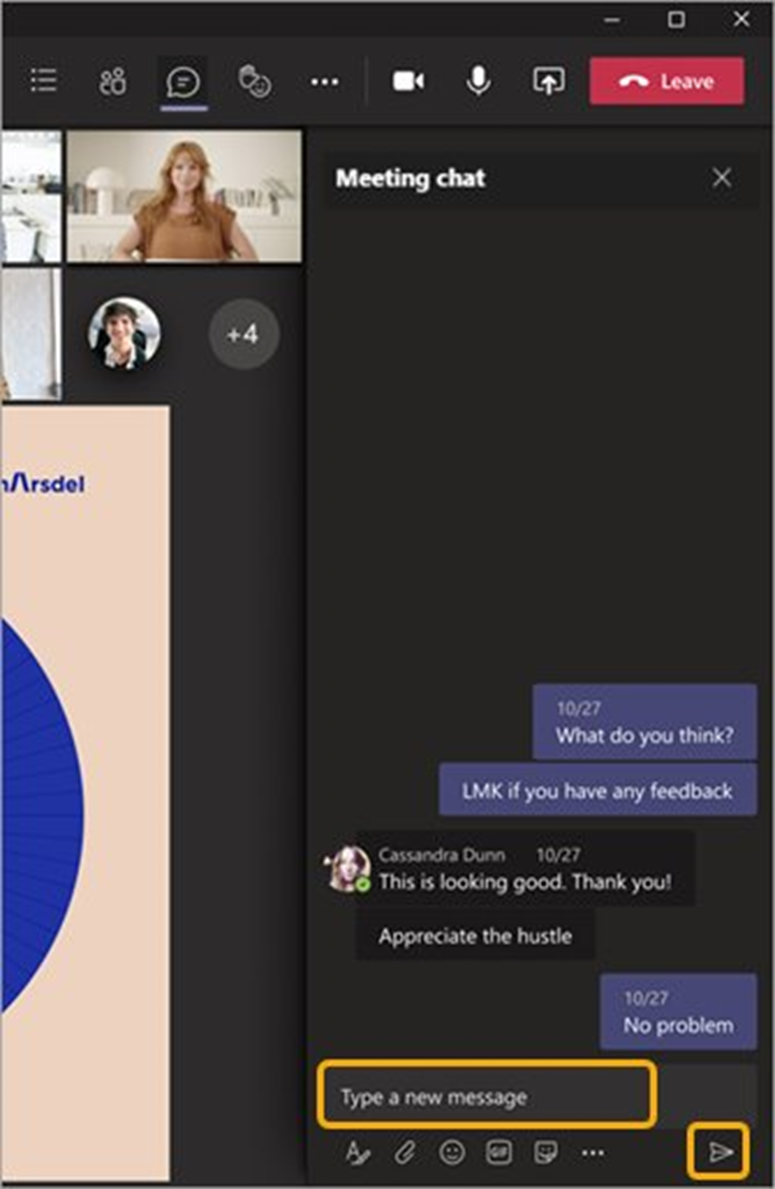
Chat Function
Share questions, comments, and ideas
Click on the message bubble icon to access the chat
Send to Everyone

Slide 4
Check out Past QI Power Hour Sessions
CPR Racism: A guide for healthcare providers to address racism in health care
Increasing primary care access: Practical, clinic driven quality improvement
Speaker: Dr. Holly Graham
Speaker: Aubrey Tollefson
saskhealthquality.ca/training-webinars/qi-power-hour-webinars

Slide 5
QI Power Hour is shared from across Saskatchewan…
Across Canada…
And around the world

Slide 6
REGISTER IN ADVANCE…
Humans Leading Humans – How Human Centered Leadership is Making a Difference
FRIDAY, MARCH 28 9 a.m. to 10 a.m. CST
Trillium Health Partners
WENDY CAMPBELL, KATEY KNOTT, SHELLY PETRUSKAVICH

Slide 7
Join our QI Power Hour mailing list
Receive notices about upcoming sessions and registration details straight to your inbox.

Slide 8
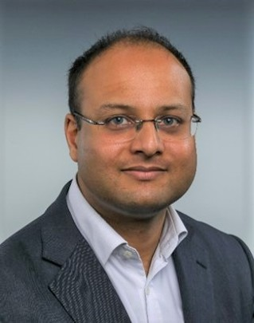
Dr. Amar Shah is Consultant forensic psychiatrist & Chief Quality Officer at East London NHS Foundation Trust where he has embedded a large-scale quality improvement infrastructure and quality management system. He is also the first National Clinical Director for Improvement at NHS England where he leads the application of improvement across England’s health and care system, and the national improvement lead for mental health at the Royal College of Psychiatrists.
Amongst several other titles, Dr. Shah is a talented national and international keynote speaker at healthcare conferences and has published over 50 peer-reviewed articles in the field of quality management.
Dr. Amar Shah

Slide 9
What does it really take to create a culture of continuous improvement?
Dr Amar Shah

Slide 10
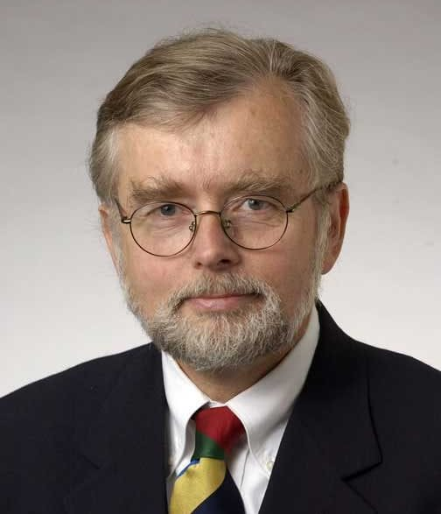
“In healthcare everyone has two jobs:
to do your work, and to improve it.”

Slide 11
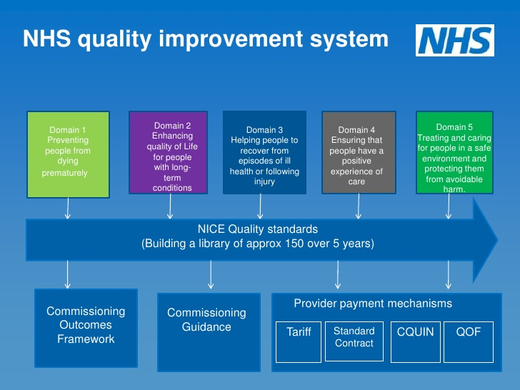
First, let’s define what we mean by improvement…

Slide 12
What are the core characteristics of improvement?
Tackling a complex problem
Diverse representation, from those closest to the problem
Applying a systematic method
Theory-building
Testing and learning
Use of data over time

Slide 13
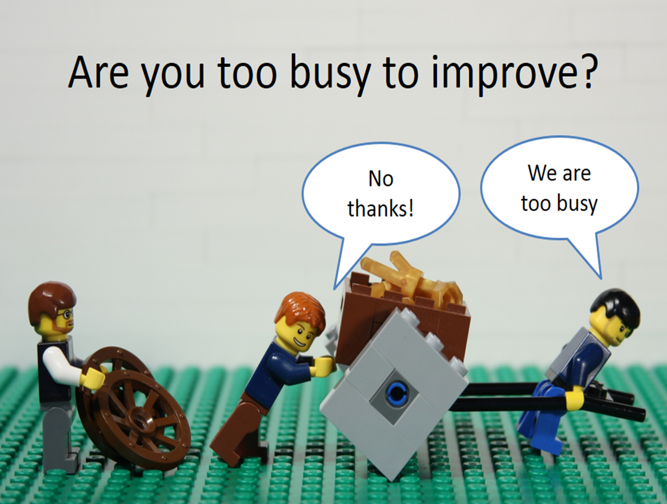

Slide 17
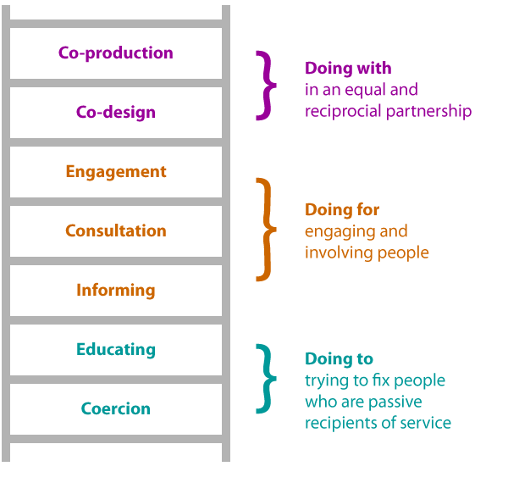

Slide 18
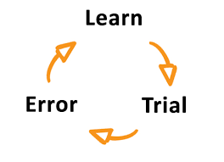

Slide 21
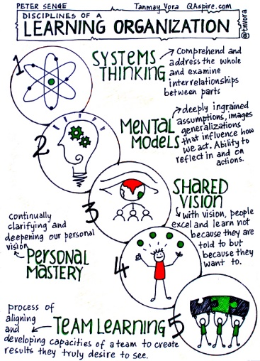
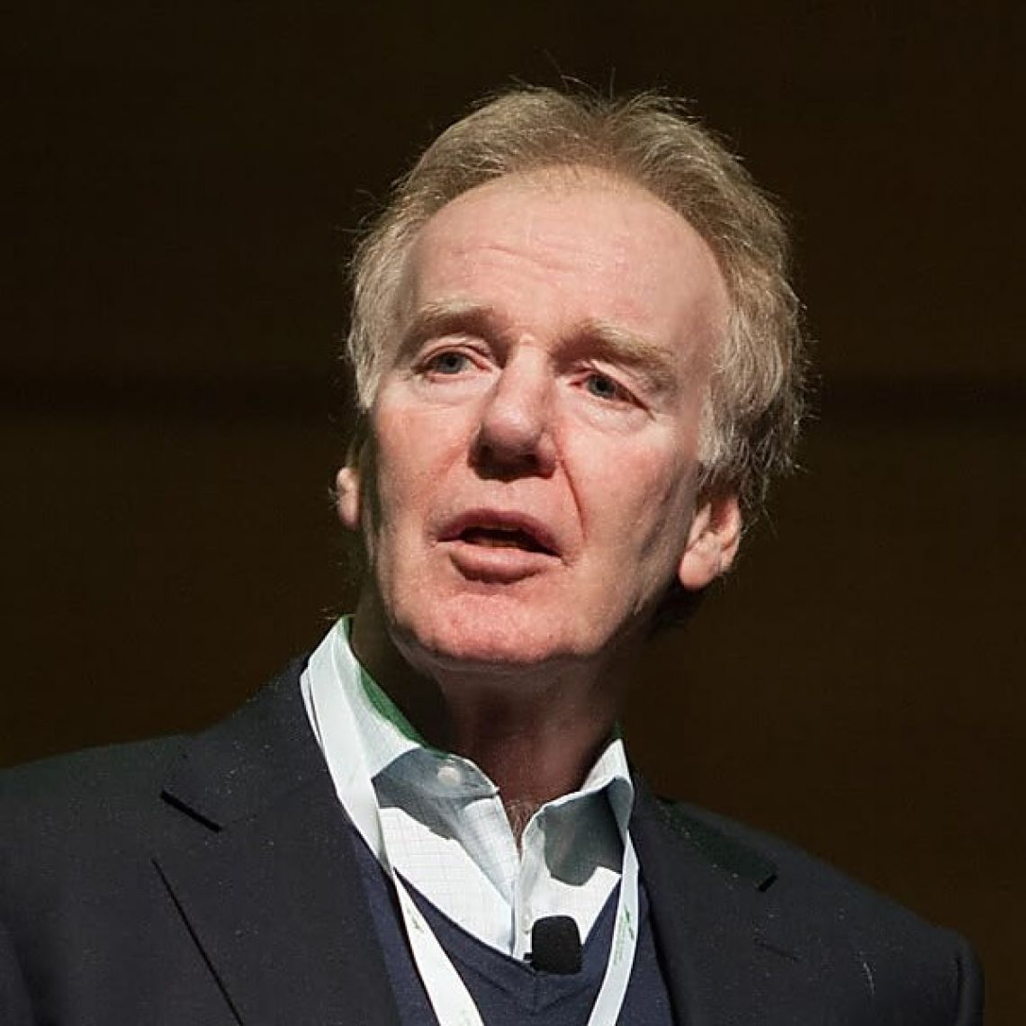
A Learning Organisation
“…where people continually expand their capacity to create the result they truly desire, where new and expansive patterns of thinking are nurtured, where collective aspiration is set free, and where people are continually learning how to learn together”

Slide 24
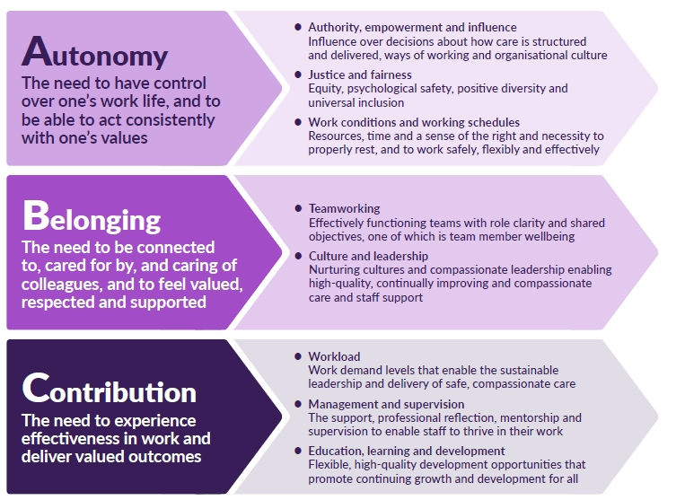
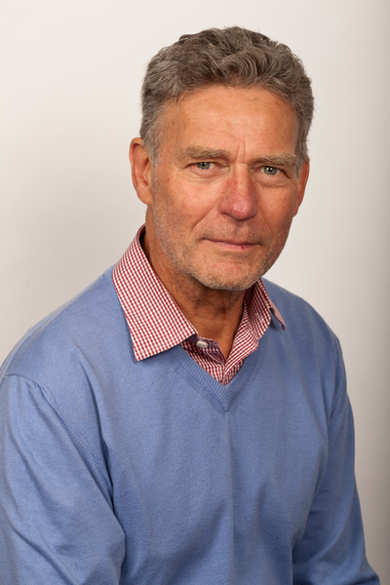

Slide 25
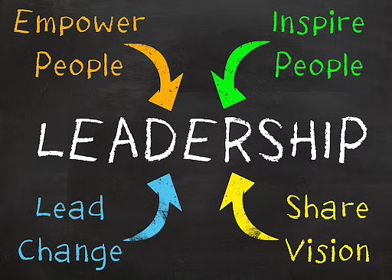

Slide 26
Relational
Technical

Slide 27
What can this create?
Autonomy and control
Connection to purpose
Finding ways to manage workload and demand
Preventing burnout and creating joy
Solution-focus
Optimism and hope

Slide 28
When demand outstrips your capacity…

Slide 29
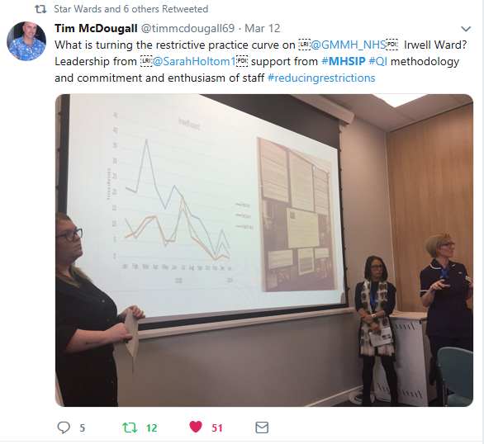
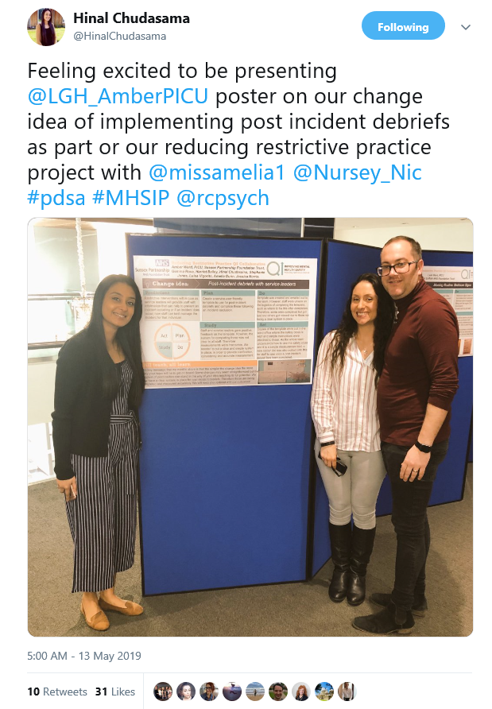
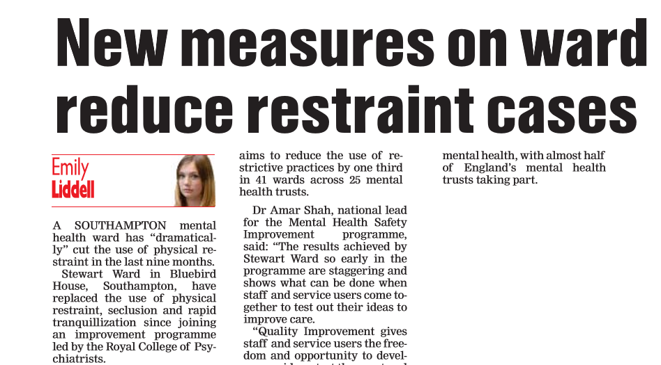
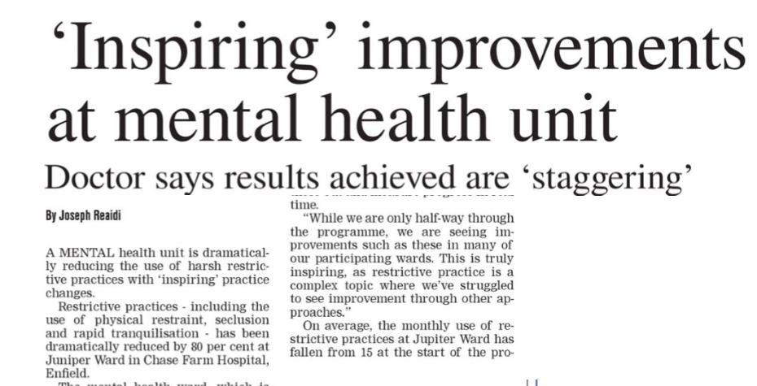
Better safety solutions…
38 teams from 25 organisations
18 month programme
Close QI support
300+ change ideas tested
24 teams achieved a sustained reduction
15%

Slide 30
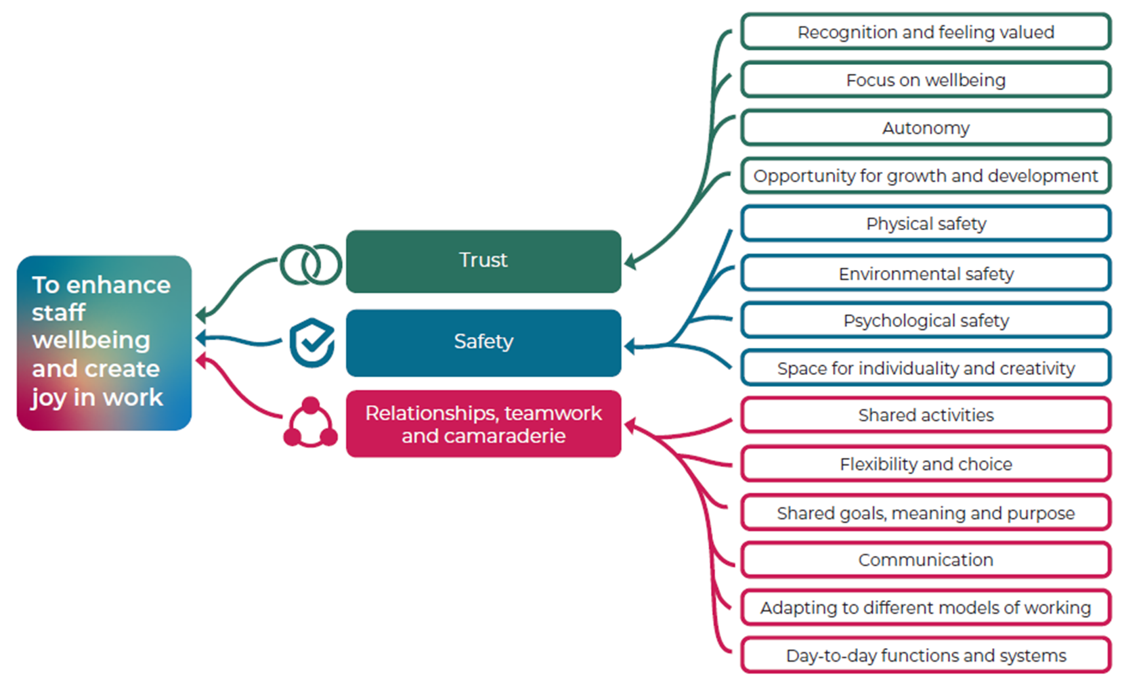
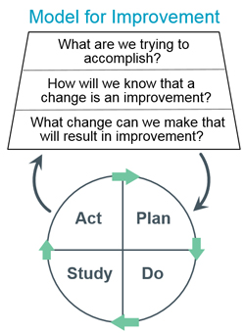
To enhance staff wellbeing and create joy in work

Slide 31
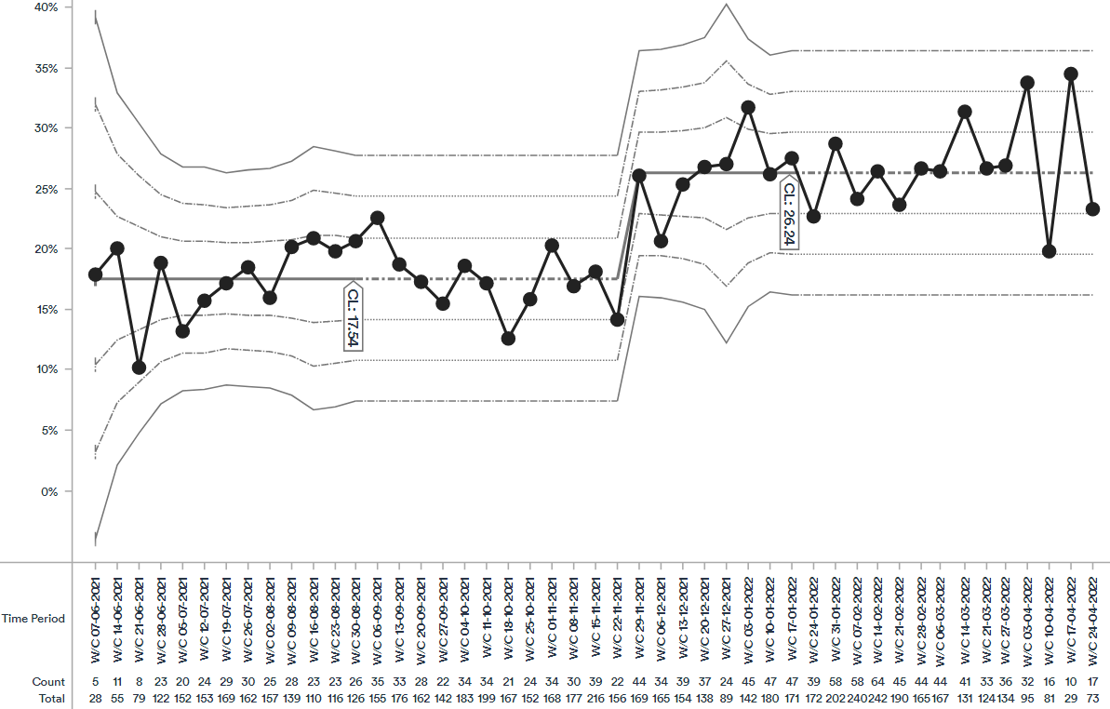
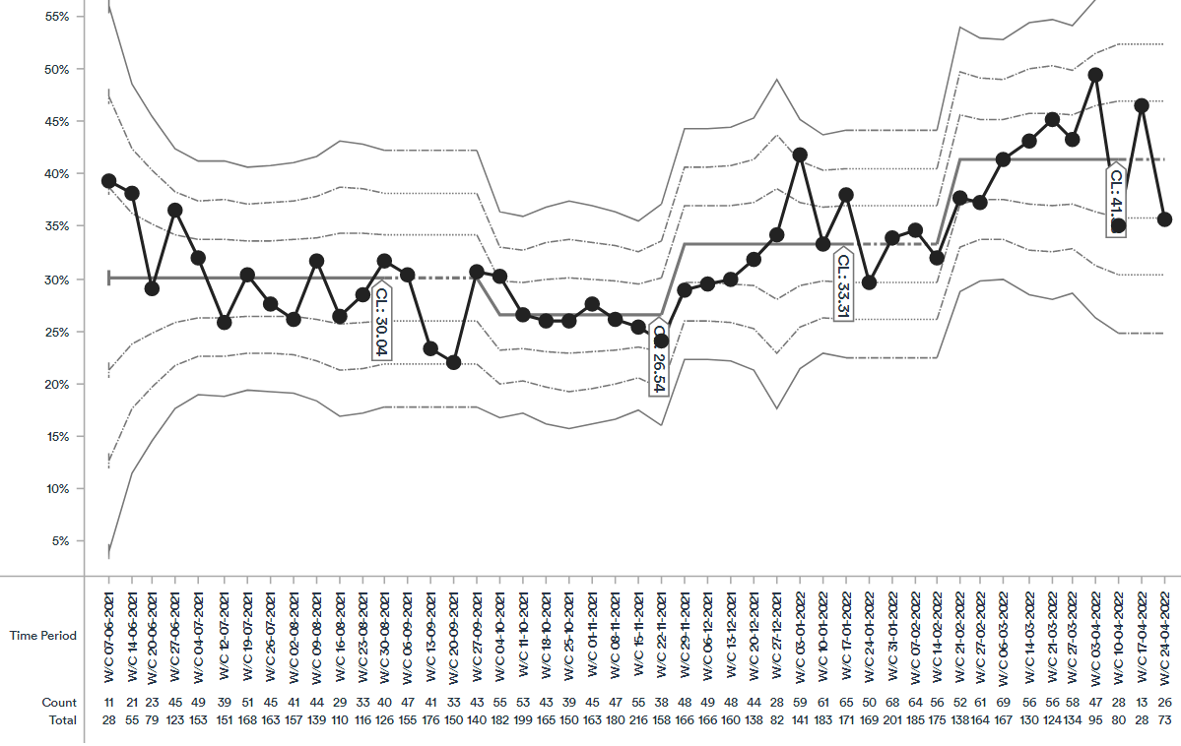
Enjoying work
% people who have enjoyed being at work frequently
26%
18%
Burnout
% people who experience no symptoms of burnout
33%
24%
Recommending team as a place to work
% people who are extremely likely to recommend their team as a place to work (9 or 10 out of 10)
41%
31%

Slide 33
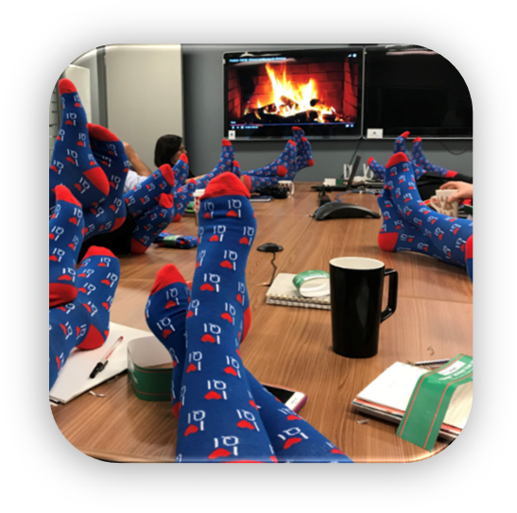
Want to rep your love for quality improvement?
Become a QI Power Hour speaker!
Register
Get your socks
Scan to sign up!
Present
Receive socks!
Speak at Power Hour!

